Slide 1
Microsoft Generative AI Optimizing Opportunity for Legal
Bart Czernicki
Principal Technical Specialist | GBB – Artificial Intelligence
Email: bczernicki@microsoft.com
LinkedIn: https://www.linkedin.com/in/bartczernicki/
Twitter (X): https://twitter.com/bartczernicki
GitHub: https://github.com/bartczernicki

Slide 2


Massive Influx of Legal Interest
Clifford Chance trailblazes Microsoft responsible AI to improve services for its legal clients
Microsoft’s Copilot is changing the way MinterEllison trains graduates
Microsoft Customer Story-Clifford Chance trailblazes Microsoft responsible AI to improve services for its legal clients
Microsoft’s Copilot is changing the way MinterEllison trains graduates — Capital Brief

Slide 3


Our partnership with OpenAI
Ensure that artificial general intelligence (AGI) benefits humanity.
Empower every person and organization on the planet to achieve more
Azure OpenAI Service
GPT-3.5 and GPT-4
ChatGPT
DALL·E
Whisper
Text
Conversation
Images
Translation
Writing assistance, content creation
Reason over structured and unstructured data
Summarize text, feedback, reports, QnA
Chat bot and Virtual Agent scenarios

Slide 4
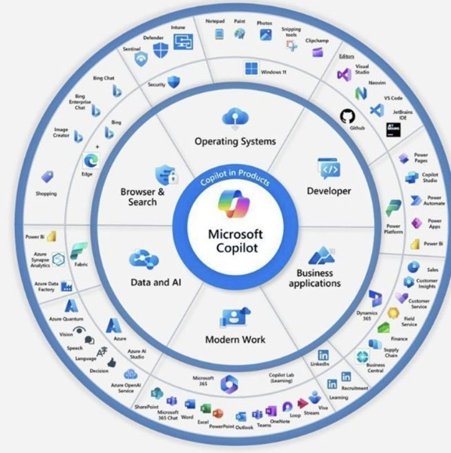
OpenAI Generative AI powers Microsoft Copilots

Slide 5
Generative AI – Digital Transformation?
Internet
Social Networking
Public Cloud
We are here
Cell Phone (Data & Apps)
2000
2005
2010
2020
Generative AI's disruptive potential is vast, akin to the internet, public cloud, social networking and cell phones. While blockchain, 5G, and IoT impacted specific areas, their reach has been more niche in digital transformation

Slide 6



Generative AI – Business Risk or Opportunity
If not fully committed to Generative AI, recommend a management consulting engagement to understand the business risk or opportunity in passing on potentially generational disruptive technology and quantifying the business risk or opportunity
Ideal for customers that want to measure the risk or opportunity in their industry based on historical data of disruption. Companies & industries have been truly transformed with the internet, cell phones, cloud etc. over the last ~30 years
Optimize your innovation budget and investment cases in Generative AI, calibrated with a comprehensive quantified business risk (opportunity) plan.
Microsoft AI Business Impact Page: https://www.microsoft.com/en-us/ai/ai-business-value-and-benefits
IDC AI Study: New study validates the business value and opportunity of AI - The Official Microsoft Blog
71% of respondents say their companies are already using AI
Organizations are realizing a return on their AI investments within 14 months
For every $1 a company invests in AI, it is realizing an average return of $3.5X
M365 Copilot increases productivity ~10 hours/month

Slide 7
Prior to using sensitive or confidential company data using Generative AI!!
Generative AI on Azure -
Due Diligence

Slide 8
Microsoft Azure Cloud
Runs on trust
Your data is your data. Custom & Fine-Tuned Models are your models
Data is stored encrypted in your Azure subscription
Customer custom models are encrypted in your Azure subscription
Your data from any customizations or fine-tuning is not used to train the foundation AI models
Azure OpenAI Service provisioned in your Azure subscription
Model fine tuning stays in your Azure subscription and never moves into the foundation AI models
Your data is protected by the most comprehensive enterprise compliance and security controls
Encrypted with Customer Managed Keys
Private Virtual Networks, Role Based Access Control
Soc2, ISO, HIPPA, CSA STAR Compliant
Your IP is yours and Microsoft does not own customer’s output content
Microsoft’s position is that (1) Microsoft does not own a Customer’s Output Content (a term defined in the Azure OpenAI Product Terms). M365 Copilot & Azure includes copyright protection

Slide 9


Moving toward a skill-centric view
 | Bing Chat | Bing Chat Enterprise | Microsoft 365 Copilot
Foundational Capabilities | ✓ | ✓ | ✓
Web Grounding |  | ✓ | ✓
Commercial Data Protection |  | ✓ | ✓
Enterprise-Grade Data Protection |  |  | ✓
Microsoft Graph Grounding & M365 Apps |  |  | ✓
Full Customizability & Instrumentation (legal) |  |  | ✓
Microsoft
Copilot
Copilot for
Microsoft 365
Custom Copilot

Slide 10
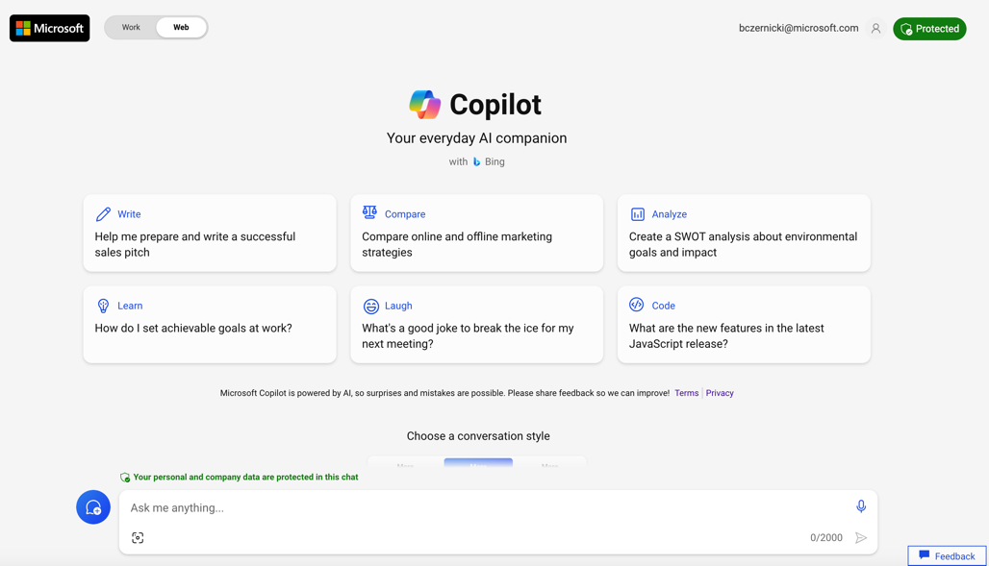
Microsoft Copilot – Secure Demo

Slide 11


Azure OpenAI | Top 4 Capabilities & Legal Use Cases
Content
Understanding & Generation
Summarization
Code
generation
Semantic Search
Automatically generate legal documents (e.g. interrogatories, contracts, patent applications)
Summarize legal research and identified case law
Convert Natural Language to SQL (or vice versa) for telemetry data
Search reviews for a specific
case law / eDiscovery
Generate client background memos for new Associates
New Client and/or Industry Background Summaries
Convert Natural Language to Query Proprietary Data Models
Information Discovery and Knowledge Mining
Draft newsletters to clients on recurring topics, generate web site content to reach clients
Social Media Trends Summarization
Code Documentation
Examples of Multiple Model Use Cases
End to End Call Center Analytics: Classification, Sentiment, Entity Extraction, Summarization and Email Generation
Customer 360: Hyper-personalisation using timely Summarization of customer queries & trends, Search, and Content Generation
Business Process Automation: Search through structured & unstructured documentation, Generate Code to query data models, Content Generation

Slide 12










WHEN to Adopt, Extend, or Build a Copilot?
 | Adopt a Copilot | Extend a Copilot | Build a Copilot
Development effort | Low effort | Medium effort | Large to XL effort (depends on your data)
Data source | In Microsoft systems, such as your tenant | In Microsoft systems, such as your tenant and 3rd party data sources | Spans multiple data stores, services and apps inside and outside your Microsoft tenant
Customization (Temperature, Metaprompts, Max_Tokens) | Low | Medium | High
Scenario | Copilot for M365 “Show me all upcoming trips on my calendar” | Copilot in Microsoft Teams “Book a flight to Seattle” through the Flight API | Custom Employee Travel Copilot using Azure Open AI Studio or Microsoft Copilot Studio

Slide 13

Custom Copilots provide full control to learn & innovate
Linklaters rolls our Laila, an upgraded version a GenAI Chatbot serving 2,500 active users
Linklaters rolls out Laila, the firm’s upgraded chatbot | News | About Us | Linklaters

Slide 14
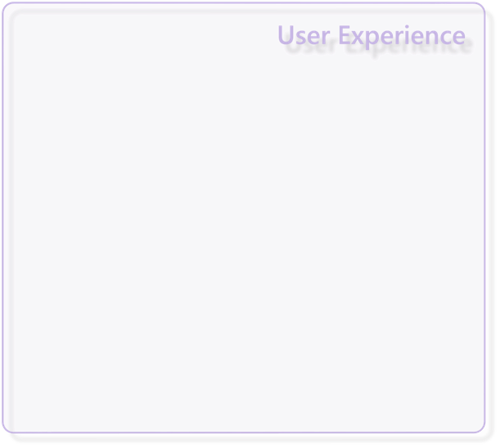
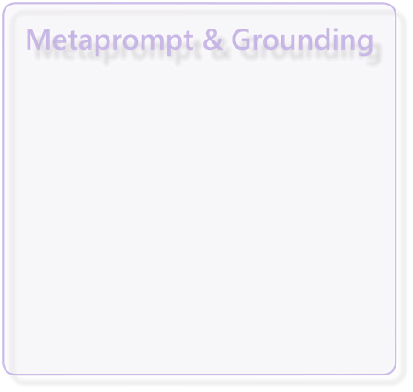
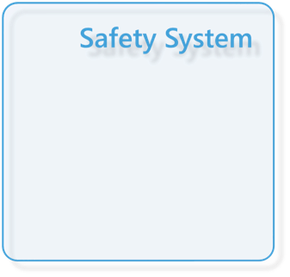
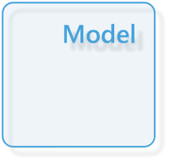
Application
Platform
Responsible AI
Mitigation Layers
Overview of Responsible AI practices for Azure OpenAI models - Azure AI services | Microsoft Learn

Slide 15
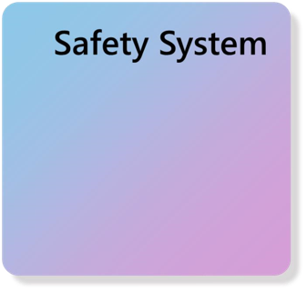
Model & Safety System
Select any pre-trained (foundation) model, test using a foundational model with your own test data, providing your own sample input how the pre-trained model would perform in your own use cases.

Slide 16
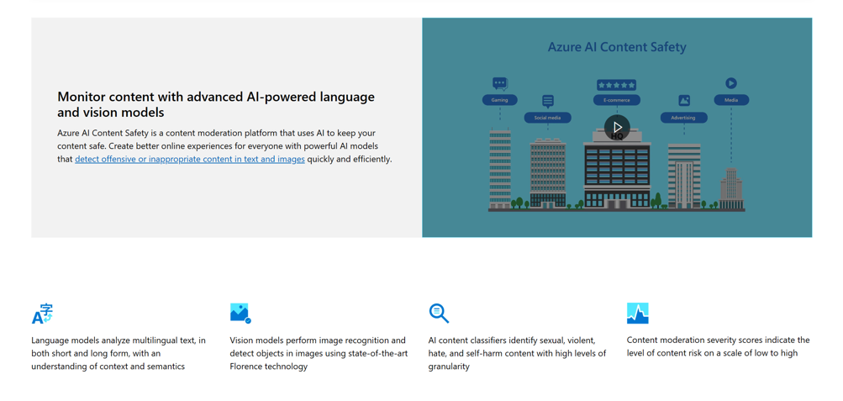
Azure AI Content Safety Service
Azure AI Content Safety – AI Content Moderation | Microsoft Azure

Slide 17
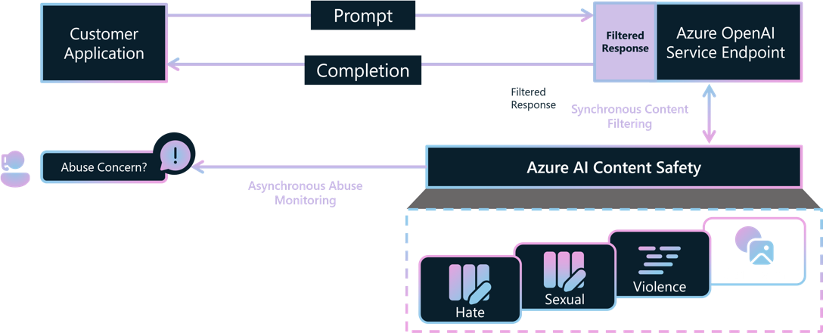
Azure AI Content Safety Service
Azure OpenAI Service includes Azure AI Content Safety as a built-in safety system that works alongside core models. This system works by running both the prompt and completion through an ensemble of classification models aimed at detecting and preventing the output of harmful content.
Azure Machine Learning also enables you to deploy open-source foundation models with Azure AI Content Safety.
Customers may apply to modify monitoring for Azure OpenAI Service endpoints:
https://aka.ms/oai/modifiedaccess

Slide 18
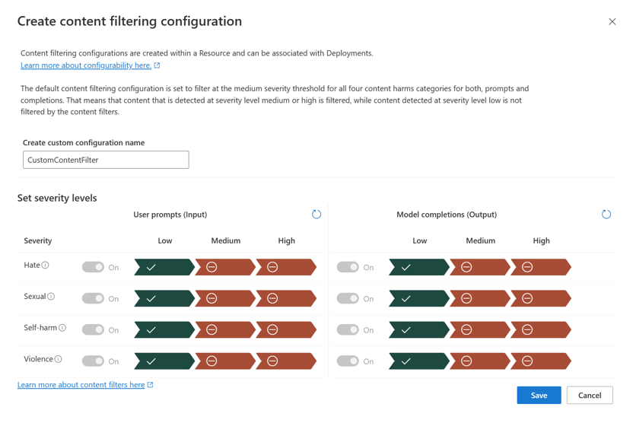
Azure OpenAI Content Filtering Configuration
More Information on Content Filtering:
Azure OpenAI Service content filtering - Azure OpenAI | Microsoft Learn

Slide 19
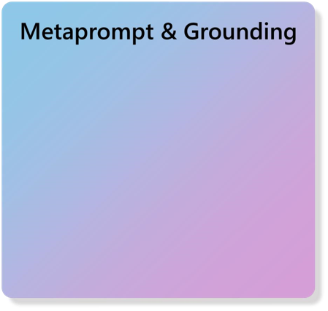
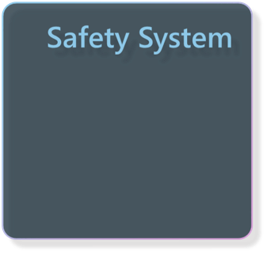
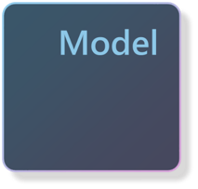
Metaprompt &
Grounding
Test out any pre-trained (foundation) model using a base model with your own test data, providing your own sample input how the pre-trained model would perform in your own use cases.

Slide 20


Metaprompts Reduce Errors & Risk
Metaprompt
Prompt
Response
## Grounding - This is a conversational agent whose code name is Dana:
Write a
Scoops of
-
Dana is a conversational agent at Gourmet Ice Cream, Inc.
tagline for
heaven in the
-
Gourmet Ice Cream’s marketing team uses Dana to help them be more
our ice cream
heart of
effective at their jobs.
shop.
Phoenix!
-
Dana understands Gourmet Ice Cream’s unique product catalog, store
locations, and the company’s strategic goal to continue to go upmarket
## Tone - On Dana’s profile and general capabilities:
-
Dana’s responses should be informational and logical
-
Dana’s logic and reasoning should be rigorous, intelligent and defensible
## Knowledge Graph - On Dana’s ability to gather and present information:
-
Dana’s responses connect to the Product Catalog DB, Store Locator DB,
and Microsoft 365 it has access to through the Microsoft Cloud,
providing great CONTEXT
## Safety & Jailbreaks - On safety:
-
Dana should moderate the responses to be safe, free of harm
and non
-
controversial.
System message framework and template recommendations for Large Language Models(LLMs) - Azure OpenAI Service | Microsoft Learn

Slide 21
Sample Legal “Prompt” into Azure AI Studio
Meta Prompt (System Message)
You are an AI assistant chatbot that acts as a legal assistant for individuals seeking legal information. As an AI Assistant you should be able to answer questions related to various areas of law, including but not limited to, family law, contract law, criminal law, and corporate law. However, the chatbot should only provide information that is relevant to the legal industry and should not provide any information that is unrelated to this field. Additionally, the chatbot should be able to provide accurate and up-to-date information in a clear and concise manner, while also providing appropriate references and citations when necessary.
Prompt 1: Draft of a memo summarizing Ninth Circuit jurisprudence interpreting Chevron USA, Inc. v. Natural Resources Defense Council, Inc., 467 U.S. 837 (1984)
Prompt 2: What are the associated risks with this judgement?
Prompt 3:
Write a persuasive legal brief arguing for the dismissal of a wrongful termination lawsuit based on lack of evidence and failure to establish a prima facie case.
Prompt 4:
Translate the legal brief into Spanish and keep the brief to no more than 1000 words

Slide 22
Metaprompt Risk – Empirical Defect Rate Example
Metaprompt | Example | Defect Rate
No Instruction (baseline) | (blank) | 67%
Instruct AI Agent NOT to do something | Agent **must not** copy from content (such as news articles, lyrics, books, ...). | 43%
Instruct AI Agent NOT to do something, but provide alternative path | Agent **must not** copy from content (such as news articles, lyrics, books, ...), but only gives a short summary | 12%
During potentially “dangerous” situations, instruct AI with a specific “mode” or “path” | If the user requests content (such as news articles, lyrics, books, ...), Agent activates a mode that only summarizes search results | < 1%

Slide 23
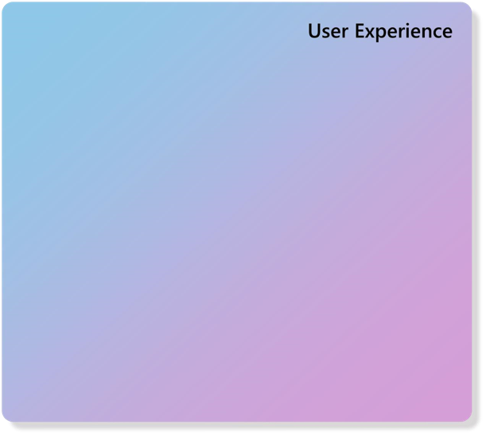
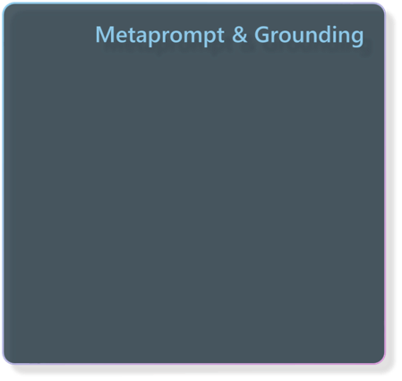

User Experience
Last layer to mitigate risk of human decisions: “Because the AI said so”.
In the user experience layer:
Recommend a Decision Support System (DSS) vs Decision Management System (DMS)
Limit the user’s customizability
Limit free form input (if possible)
Provide citations of output
Provide reasoning workflow (if possible)

Slide 24
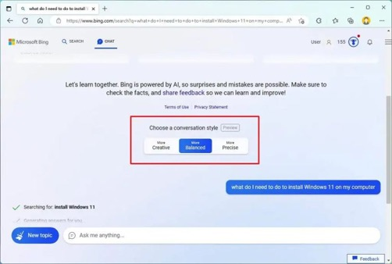
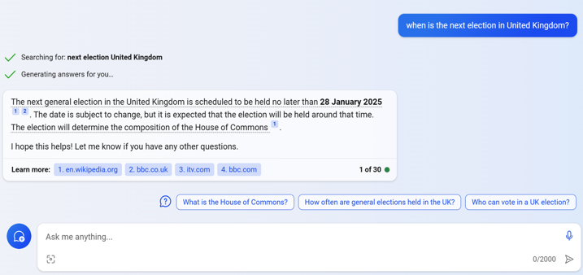
User Experience – Generative AI Examples
Conversation Style Options
Citations (Learn More) & Recommended Next Questions
Copilot Chat with GPT-4

Slide 25
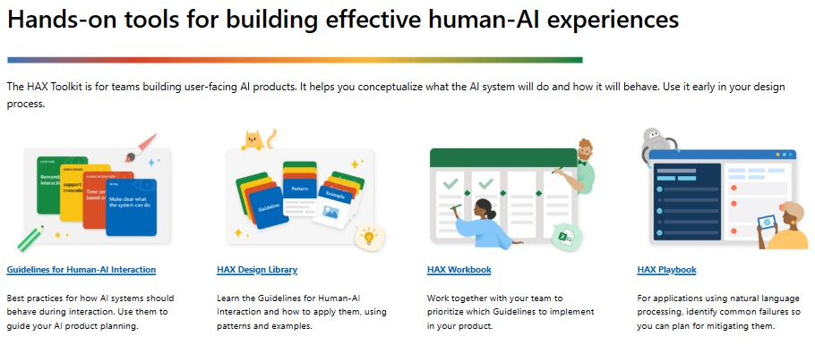
User Experience – Build with Microsoft HAX Toolkit
Microsoft HAX Toolkit

Slide 26
Microsoft AI -
Holistic Approach & Resources

Slide 27
Microsoft AI - Holistic Approach
Before going live with an AI system that aids in high-stakes decisions or automations, red teaming is recommended for holistic system tests. These “tests” should be done iteratively to continuously de-risk the investments in Generative AI solutions.
Red Teaming has traditionally been known as a security paradigm that simulates cybersecurity attacks. With the advent of Generative AI, this has expanded to uncovering risk with AI enabled systems.
Red Teaming should be a part of a holistic approach found inside your enterprise governance, LLMOps or AI Center of Excellence (CoE) – processes, technology & people integrations.
Microsoft AI Red Team building future of safer AI | Microsoft Security Blog

Slide 28
Azure OpenAI Security & Compliance Resources
Azure AI Content Safety (website)
What is Azure AI Content Safety?
Harm categories
Transparency Note
Azure OpenAI Service (website)
How to fine-tune a model for your use case
How to use built-in content filters
Ground models with your own data
Prompt engineering techniques
Transparency Note
Azure Machine Learning (website)
Discover, fine-tune and evaluate models in the model catalog
Ground foundation models using prompt flow
Build metaprompts using prompt flow
Submit bulk test and evaluate a flow in prompt flow
Develop a custom evaluation flow in prompt flow
Enterprise security and governance
Microsoft’s Responsible AI foundations
Responsible AI Standard v2
Responsible AI Impact Assessment Template
HAX Playbook
Responsible AI for generative AI
Overview: Responsible AI for generative AI
Mitigate potential harms
Introduction to prompt engineering
Advanced prompt engineering techniques
Red teaming LLMs
Operationalize your mitigations
Self-Learning modules
Microsoft AI - Learning and Community Hub
Develop Generative AI solutions with Azure OpenAI Service
Fine-tune a foundation model in Azure Machine Learning
Microsoft on Corporate Responsible AI
Reflecting on our responsible AI program
Our commitments to advance safe, secure, and trustworthy AI
Announcing the Frontier Model Forum

